Slide 1
INO & NEKO
Marketing Analysis

Slide 2
Presentation By: Fahad Iftikhar
LinkedIn: LinkedIn Profile
Complete Project: github-case-study-link

Slide 3
INO & NEKO
Marketing Analysis

Slide 4
About the Data
This data was collected for merketing analysis of two different ad platforms AdWords and Facebook Ads.
This data was collected for the whole year of 2019.
Ad Clicks and Conversions data has a normal distribution.
Project Purpose/ Evaluation Question
To find the difference between how the ads perform on different ad platforms and change our marketing strategies

Slide 5
Statistics of Data
 | Facebook Ad Clicks | Facebook Ad Conversion | AdWords Ad Clicks | AdWords Ad Conversion
Mean | 44.04931507 | 11.74246575 | 60.38356164 | 5.980821918
Median | 43 | 12 | 60 | 6
Mode | 36 | 13 | 78 | 5
Standard Deviation | 12.14055871 | 2.924785979 | 14.36822476 | 1.62810629
Correlation Coefficient | 0.873775015 | 0.873775015 | 0.447993201 | 0.447993201

Slide 6
Frequency and Contigency Tables
Understanding how often something happens is important to understanding trends and patterns in our data.
Number of AdWords Conversions by Grouping for 2019 | Number of AdWords Conversions by Grouping for 2019
Range of Conversions | 1 to 5 | 6 to 10 | 11 to 15 | 16+
Number of Occurences | 156 | 209 | 0 | 0
Number of Facebook Conversions by Grouping for 2019 | Number of Facebook Conversions by Grouping for 2019
Range of Conversions | 1 to 5 | 6 to 10 | 11 to 15 | 16+
Number of Occurences | 1 | 128 | 189 | 47

Slide 7
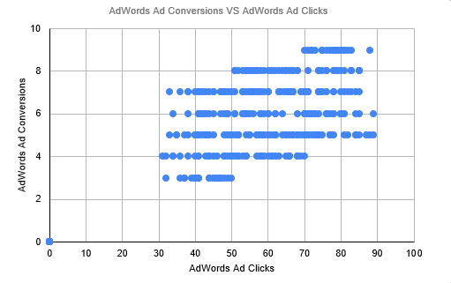
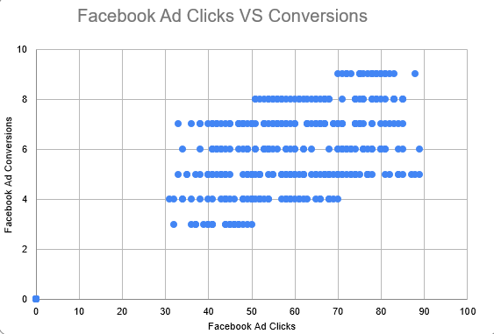
Scatter Plot
Understanding the relationships between data is important to understanding trends and patterns.

Slide 8
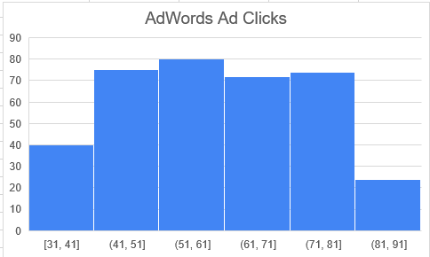
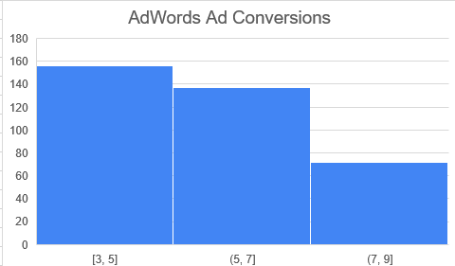
Histogram Comparison
This histogram shows the AdWords click to conversion ratio
Histogram of AdWords clicks data:
Histogram of AdWords conversion data:

Slide 9
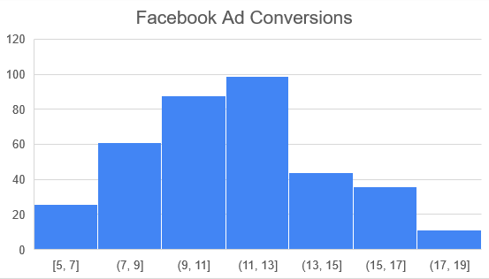
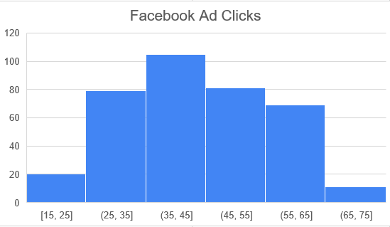
Histogram Comparison
This histogram shows the Facebook click to conversion ratio
Histogram of AdWords clicks data:
Histogram of AdWords conversion data:

Slide 10
Question and Hypothesis
Evaluation Question: We will double our conversions if we advertise more on Facebook, compared to AdWords.
H0 – No, our conversions won’t double if we advertise on Facebook rather than AdWords
H1 – Yes, our conversions will double if we advertise on Facebook rather than AdWords.

Slide 11
Modelling
We used simple linear regression model in this case as we have two quantitive variables and the purpose is to predict the dependent variable using independent variable.
In this case we are using number of clicks to predict number of conversions.

Slide 12
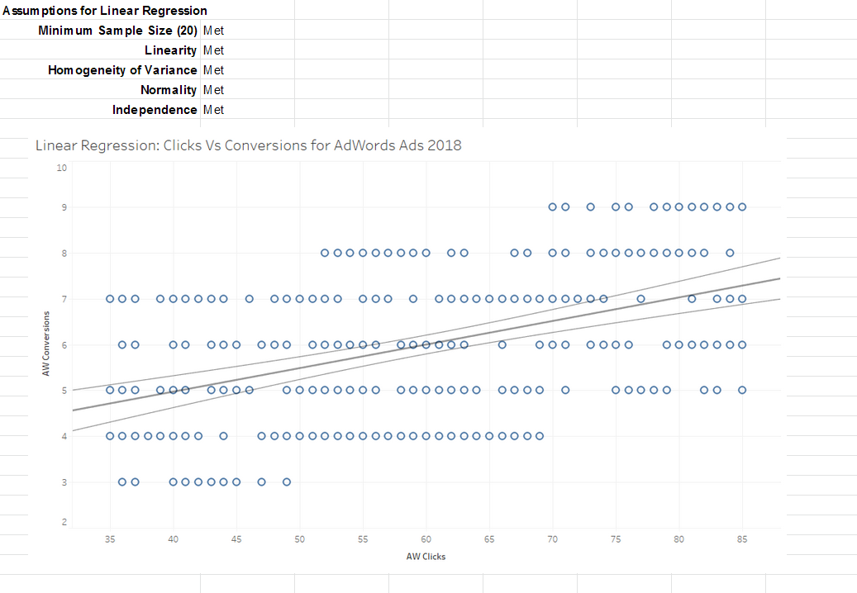
Model

Slide 13
Final Insinghts
Based on accepting the H1 hypothesis, we found out that advertising on Facebook rather than AdWords brings twice more conversions.
Applying the SLR model we can now forecast and predict how many conversions we might generate based on the clicks from our Facebook ads.
This data also has 26% conversion rate from people who clicked the ad which is a good number.
In conclusion we should shift our focus more towards Facebook as it brings in more conversions compared to AdWords.

